Slide 1
Tools for Data Manipulation & Management
Jeremy Bergmann - Omaha Data Science Academy

Slide 2
Quiz: Class 4
Purpose of Database Modeling
Entity-Relationship Diagrams
SQL Constraints & Relational Database Modeling
Normal Forms: 1NF, 2NF, 3NF
Dimensional Data Modeling: Kimball
Database Modeling
Notes:
Feynman technique: Learn -> Explain -> Reflect -> Repeat
What are the most important ideas from last class? Write a summary of the information as if explaining to a 14 year old. Avoid jargon Keep the words and sentences simple Rely on memory Make the explanation visual, if possible Note where you had difficulty or have knowledge gaps. These indicate things you should review, research, or ask questions about

Slide 3
Class 5 Objectives
ETL & Workflow Tools: Talend, Python, Dataiku
Cloud Storage: Google Cloud, AWS, Microsoft
NoSql Introduction
Finish Class Project - Data Visualization using MySQL
Notes:
Feynman technique: Learn -> Explain -> Reflect -> Repeat
What are the most important ideas from last class? Write a summary of the information as if explaining to a 14 year old. Avoid jargon Keep the words and sentences simple Rely on memory Make the explanation visual, if possible Note where you had difficulty or have knowledge gaps. These indicate things you should review, research, or ask questions about

Slide 4
Review
It is important to…
know the tool space for doing certain types of work (like storing and manipulating data)
What are the latest tools?
What are the most popular tools among individuals/companies?
know the degree to which knowing one tool well qualifies you to work with similar tools
be comfortable finding and reading documentation
Notes:
Feynman technique: Learn -> Explain -> Reflect -> Repeat
What are the most important ideas from last class? Write a summary of the information as if explaining to a 14 year old. Avoid jargon Keep the words and sentences simple Rely on memory Make the explanation visual, if possible Note where you had difficulty or have knowledge gaps. These indicate things you should review, research, or ask questions about

Slide 5
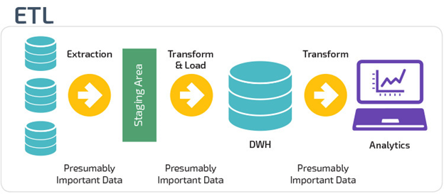
What is ETL?
ETL is short for Extract, Transform, and Load. These functions that let you take data from different formats, manipulate the data in a staging area, then write data to a target database.
The Extract stage lets you take data from different sources and allows you to pull it into a centralized staging area.
The Transform stage lets you manipulate the data with certain rules applied on the extracted data.
The goal is to load this data into the end, target database in a cleansed, uniform format.
The Load stage is the process of writing the data into the final, target database. This final target can be an operational data store, data marts, or a data warehouse.
Notes:
For example, a company may house all their data in a SQL Server database, but needs to gather their source data from Excel, CSV, Access, and JSON files. With ETL, you can take this disparate information, pull it into a staging area where you transform it, then write all the data into the target data store.

Slide 6
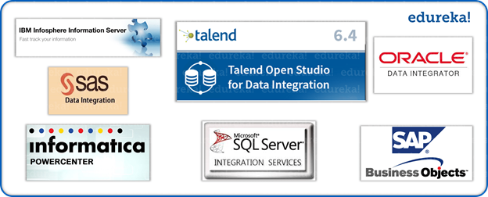
Examples of ETL Tools
There are several ETL tools available today. Many are integrated with larger Business Intelligence (BI) or Analytics platforms, while some are open source. Here are some options:
Oracle Warehouse Builder (OWB)
SAP Data Services
SAS Data Management
PowerCenter Informatica
SQL Server Integration Services (SSIS)
Talend Studio
Additionally, You can create flexible ETL & Data Quality processes using Python, using supporting libraries
bonobo: https://www.bonobo-project.org/
Python-ETL: https://pypi.org/project/Python-ETL/
pygrametl: http://chrthomsen.github.io/pygrametl/
bubbles: http://bubbles.databrewery.org/
awesome-etl: https://github.com/pawl/awesome-etl
pymysql: https://github.com/PyMySQL/PyMySQL

Slide 7

What is Talend?
Talend is becoming one of the leaders in desktop and cloud data integration. It’s an ETL tool that has many options for database, cloud and Big Data integrations. Talend offers commercial products, but there is a fully functional, free, open source option.
Some of the advantages of using an ETL tool like Talend are:
It lessens the need for writing procedures and code, since there’s an interactive GUI
This provides a visual flow of the ETL process and system logic
There are advanced tools built to do routine procedures, like cleaning data, sorting, joining, merging, and other manipulation processes
It has many integrations that support systems that are databases, cloud based software, and many file formats.

Slide 8
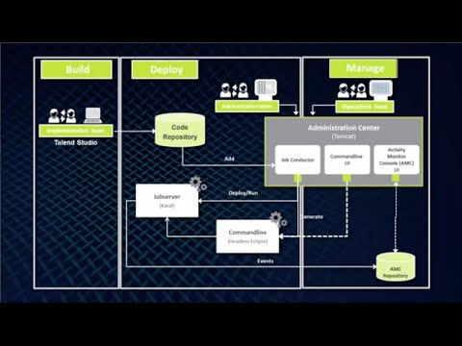
Demo - Talend Studio
Tutorials: https://community.talend.com/t5/custom/page/page-id/Tutorials

Slide 9
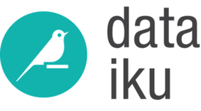
Workflow Tools: Dataiku
Steps to Engineering a Dataiku Workflow:
Create a new project
Connect to and/or Import Dataset(s)
Visual Prep - Data “Recipes”
Code Transformation(s) - Python
Visual Analysis, Data Prep & ML (The Lab)
Data Product Development
Reports, Dashboards, Insights, WebApps
Job, Workflow & Scenario Scheduling
Workflow Monitoring & Maintenance
Documentation - Wiki & Juypter Notebooks
Dataiku DSS “Bring data analysts, engineers, and scientists together”, “Enables self-service analytics” and “operationalizes machine learning” ts today and build for tomorrow.
Notes:
The Lab is a place for drafting your work, whether it is preliminary data exploration and cleansing or machine learning models creation. The Lab environment contains:
the Visual Analysis tool to let you draft data preparation, charts, and machine learning models
the Code Notebooks to let you explore your data interactively in the language of your choice
Note that some tasks can be performed both in the lab environment and using recipes in the flow. Here are

Slide 10
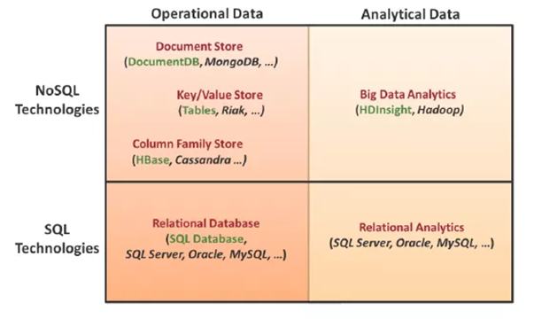
What is NoSQL?
NoSQL is a way of saying “non-relational” or an alternative to traditional relational databases. These database systems are not built on tables and do not need SQL language to be used to manipulate data.
NoSQL databases can handle semi-structured and unstructured data, which is essential in Data Science.
What are Some Examples
of NoSQL Databases?
MongoDB - Open Source
Apache Cassandra - Open Source
Couchbase - Open Source
MS Azure Cosmos DB
Amazon DynamoDB
Google Cloud Platform
Cloud Datastore
Cloud Bigtable
Notes:
NoSQL & Hadoop Intro: https://datajobs.com/what-is-hadoop-and-nosql

Slide 11
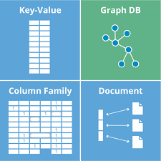
NoSQL Database Types
There are four main database types supported by NoSQL systems:
Document Databases pair each key with a complex data structure known as a document. Documents can contain many different key-value pairs, or key-array pairs, or even nested documents.
Graph Stores are used to store information about networks of data, such as social connections.
Key-value Stores are the simplest NoSQL databases. Every item in the database is stored as an attribute name (or 'key'), together with its value. Some key-value stores allow each value to have a type, such as 'integer', which adds functionality.
Wide-column Stores are optimized for queries over large datasets, and store columns of data together, instead of rows.
Notes:
A wide column store is a type of NoSQL database. It uses tables, rows, and columns, but unlike a relational database, the names and format of the columns can vary from row to row in the same table. A wide column store can be interpreted as a two-dimensional key-value store.^{[1]}

Slide 12
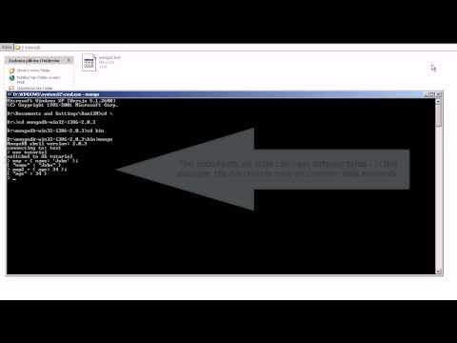
NoSQL Demo
Notes:
Relationship: OLTP = Source for OLAP

Slide 13
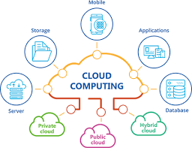
Why is Cloud Computing So Important for Businesses?
Cloud computing lets companies focus on running their infrastructure instead of housing expensive internal servers and employing a team of System Administrators.
With cloud services, businesses can spool up and manage their own servers on-demand.
Cloud services rely on shared resources, which means Amazon, Google and Microsoft supply servers in different data centers. This greatly lowers overhead in maintaining a system and increases flexibility in scaling system up and down as needed.
Notes:
Amazon, Microsoft, and Google developed their own cloud services to be used internally. Amazon originally created AWS as their internal compute, storage, database, and migration systems. The same goes for Google and Google Cloud Platform, and Microsoft and Azure. Spotify, Netflix, the Google Search Engine, YouTube, all Microsoft programs, and the Amazon Store all use one of these three cloud platforms.

Slide 14



Database Comparison
Amazon’s RDS (Relational Database Service) provides support for major databases including Oracle, PostgreSQL and MySQL.
Azure SQL & Cloud SQL offers SQL database handling features for Azure & GCP respectively.
All three offer high-performance NoSQL DB choices such as DocumentDB for Azure, Aurora for AWS & Datastore & BigTable for Google Cloud.
Notes:
Relat

Slide 15
Google Cloud - Enterprise Services
PRODUCT | DESCRIPTION | GOOD FOR
Cloud Storage | A scalable, fully managed, highly reliable, and cost-efficient object / blob store. | Images, pictures, and videos Objects and blobs, Unstructured data
Cloud Bigtable | A scalable, fully managed NoSQL wide-column database that is suitable for both low-latency single-point lookups and precalculated analytics. | Low-latency read/write access High-throughput data processing, Time series support
Cloud Datastore | A scalable, fully managed NoSQL document database for your web and mobile applications. | Semistructured application data Hierarchical data, Durable key-value data
Cloud SQL | A fully managed MySQL and PostgreSQL database service that is built on the strength and reliability of Google's infrastructure. | Web frameworks, Structured data, OLTP workloads
Cloud Spanner | Mission-critical, relational database service with transactional consistency, global scale, and high availability. | Mission-critical applications High transactions, Scale + consistency requirements
BigQuery | A scalable, fully managed enterprise data warehouse (EDW) with SQL and fast ad-hoc queries. | OLAP workloads up to petabyte scale Big data exploration and processing, (BI) tools
Drive Enterprise | A collaborative space for storing, sharing, and editing files. | End-user interaction with docs and files Collaborative creation and editing, Syncing files
Notes:
Relationship: OLTP = Source for OLAP

Slide 16
Project Milestones
Import data into MySQL database (Class 1)
Query Data for Data Understanding/Relevant Information (Class 1)
Storing/Joining data for analysis (Class 2)
Cleaning Data for Analysis (Class 3)
Analyze Data Quality & Create Data Dictionary (Class 3)
Normalize Data & Create Data Model (Class 4)
Connect MySQL to Data Visualization Tool, Answer Business Questions, Automate data workflow using ETL (Class 5)

Slide 17
Thank you!

Slide 18
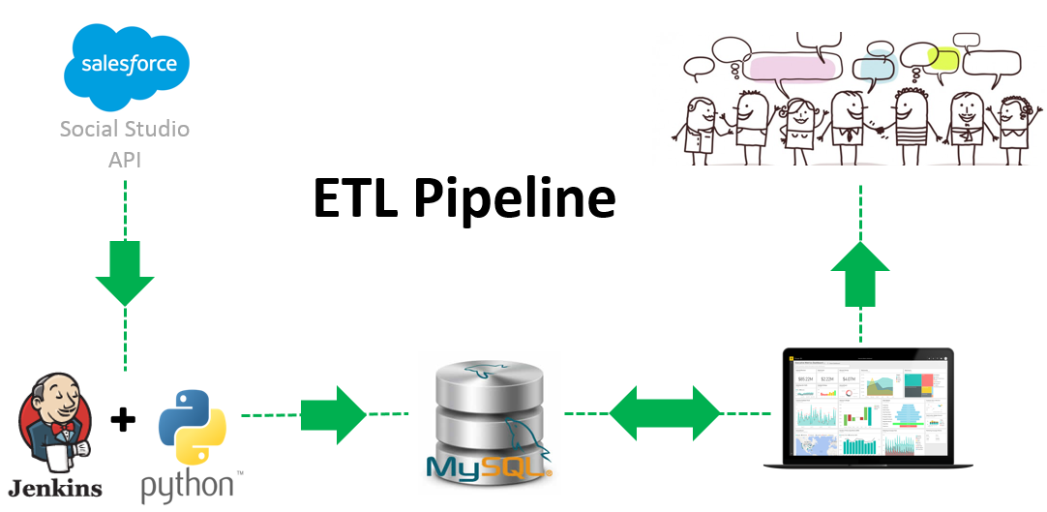
Appendix A: ETL Using Python
You can run an ETL process with either an ETL tool or by running scripts you design yourself. While there are many software based ETL tools on the market, it’s becoming more and more common to create ETL processes using a scripting language.
Why Python for ETL?
Common language for data scientists and data engineers.
Libraries that include ETL processes and connections to a variety of data sources
Databases, Files, APIs, etc.
Flexible - Adjust “on the fly” to specific project needs.
The processes are also known as “Python Pipelines”.
Python ETL & Data-Cleaning Example - Google Drive - Jupyter Notebook
Notes:
Note: Install Pandas, Numpy & PyMySQL packages
Run Python from Command-line in Windows:
Save your python code file somewhere, using "Save" or "Save as" in your editor. Lets call it 'first.py' in some folder, like "pyscripts" that you make on your Desktop.
Open a prompt (a Windows 'cmd' shell that is a text interface into the computer):
start > run > "cmd" (in the little box). OK.
Navigate to where your python file is, using the commands 'cd' (change directory) and 'dir' (to show files in the directory, to verify your head). For our example something like,
> cd C:\Documents and Settings\Gregg\Desktop\pyscripts
try:
> python first.py

Slide 19
Appendix B - Moving MySQL DB to GCP
Step 1) Create a google account, then connect to the following URL:
https://datastudio.google.com/data?search=mysql
Step 2) Create a SQL dump file of your local MySQL database
cmd line: cd C:\Program Files\MySQL\MySQL Workbench 8.0 CE
mysqldump -u root -p world > “C:\Data Manipulation\sql_world_dump.sql”
Step 3) Create a Cloud Storage bucket
Step 4) Upload SQL dump file to Cloud Storage bucket
Step 5) Go to the Cloud SQL Instances page in GCP
Use “Cloud SQL Instance Page” on link below
Select “Create Instance”
Select “MySQL”
Steps at: https://cloud.google.com/sql/docs/mysql/import-export/importing
Step 6) Fill-in the “Create a MySql Second Generation instance”
Instance ID: (database name)
Select “No Password”
Select “Create”
Step 7) “SQL Instances” should now appear - select the instance from 6)
Step 8) Click Import in the button bar.
Enter the path to the bucket and SQL dump file you uploaded
Format of import - “SQL”
Select Database - “mysql
Step 9) Navigate bace to Google Data Studio → Connect to Data
Select “Cloud SQL for MySQL” connector “ - “Create Datasource
Authorize connection
Provide Instance Connection Name/Database/Username & Pass
Step 10) Create using MySQL cloud datasource in Google
Notes:
Relationship: OLTP = Source for OLAP

